Slide 1


CRYPTO DATATHON
Team Name
Innovation Geeks
College
IIM Calcutta
FINANCIAL DELINQUENCY PREDICTIVE ANALYSIS
Girish Dev Kumar Chaurasiya
Sugandha Ranjan
Suman Pal
Name of the Participants

Slide 2

CONTENTS
Introduction
3
Problem Statement
4
Analysis
5
Exploratory Data Analysis
6
Predictive Data Analysis
11
Conclusion and discussion
14
Future Scope and recommendations
16

Slide 3
INTRODUCTION
TVS is one of India's largest diversified industrial conglomerates with its principal headquarters located in Madurai and international headquarters in Chennai.
TVS credit, a financial services company under this group, operating across 21 states, aims to empower Indians from various socioeconomic backgrounds with financial products serving their needs.
Since its inception, TVS Credit Services Limited has been providing auto financing services such as finances for bike, car, and heavy vehicles.
In addition to the existing services, in 2017, TVS Credit entered the consumer durable financing segment, thereby marking its first venture outside automobile finance.
This new venture into consumer durables poses certain challenges for the company with respect to tracking of prospective loan defaulters.

Slide 4
PROBLEM STATEMENT
For a financial services firm, It is pertinent for the company to ensure payments of installment within stipulated time period. Hence, It is vital to track customers who don’t pay the debt/EMI in time even until the end of the month. Post default on payment, these customers are termed as flow customers.
After several attempts, customers who are not able to pay in that month are moved to N+1 from N existing payment defaults i.e. moved to the next bucket.
Objective of this exercise is to predict which customer is going to flow to N+1 bucket in coming month based on their past payment history, previous month collection, demographics, profile, external data etc.

Slide 5
ANALYSIS
We shall start with exploring the variables provided in the dataset and try to understand the information it contains regarding their distribution and perform an elementary analysis on their mutual correlation.
Further, we will try to gauge and present some description pertaining to data and their mutual relationships .
Predictive analytics will be carried out in order to estimate the potential defaulters. We will then present various variables helping in estimation.
Finally, some assessments that might help TVS in future to better assess prospective defaulters and improve their performance and overall profitability.
Exploratory
Descriptive
Predictive
Prescriptive

Slide 6

EXPLORATORY DATA ANALYSIS
Following are the visual representations of the data under column V4, V3 and V18 out of which V4 indicate that most of the customers (75%) tend to pay their EMI on time, however around 25% of them have defaulted at least once in last 3 months. Variable V3 provides a further detailed information on a similar area. It is also pertinent to note that around 56% of the costumers have education levels of below 12th which might be a crucial information as education levels might affect chances of defaulting.
Number of times the customer flowed in the last 3 months
Total number of times the customer flowed so far
Qualification

Slide 7
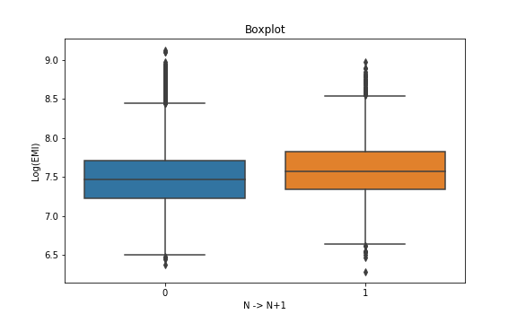
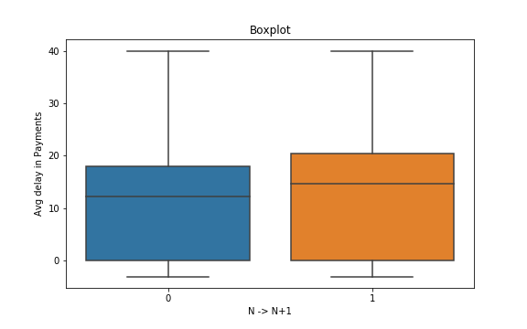
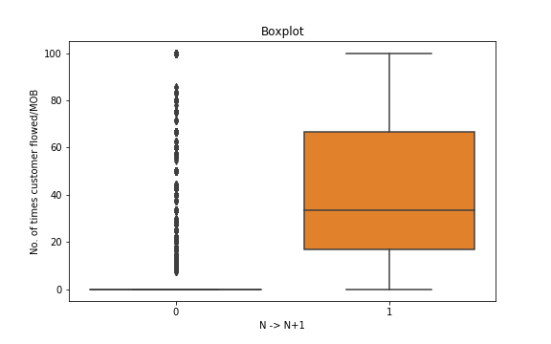
EXPLORATORY DATA ANALYSIS
As it is clear from the boxplot below, Higher level of EMI is more likely to default. Average delay in case of defaulter shows a higher level of variance. Also it is apparent, that the defaulters tend to have comparatively a higher level of delay.
One of the important variables to note is no. of times customer has flowed in past. We can interpret from the boxplot that a customer who flowed in part is highly likely to flow again.

Slide 8
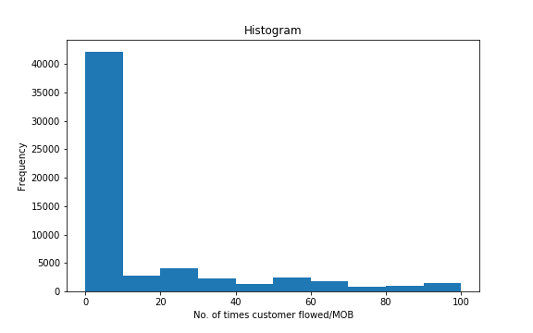
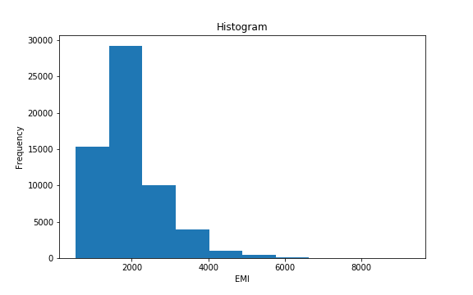
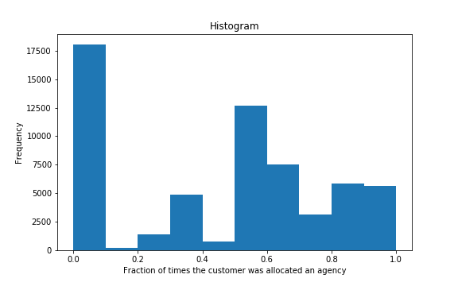
EXPLORATORY DATA ANALYSIS
From the histogram plot of EMI(V16), it is evident that the customers with low EMI (between 0-2000) are more in no. and hence,
the graph is positively skewed. The distribution of No. of times customer flowed/Month On Book (V20) shows that most of the customers fall in the range of (0-20) and remaining values have significantly less no. of customers. Fraction of times the customer was allocated to a collection agency (V25) has high no. of customers for values greater than .5 as well as for 0.

Slide 9
EXPLORATORY DATA ANALYSIS
The frequency plot depicts the relationship between the defaulter count and Qualification. It can be inferred that although the proportions in all categories are comparable, it still differs and decreases with increase in education levels.

Slide 10
EXPLORATORY DATA ANALYSIS
The adjacent two plots show the relation of the number and proportion of defaulters with respect to no. of times customer flowed in the last 3 months(V4) and total no. of times(V3). It can be seen that for customers who do not default at all in the last 3 months or otherwise, the defaulter count/proportion is very low. As the number of times of default in past increases, the chances of defaulting in the current month increases.
-Number of times the customer flowed in the last 3 months

Slide 11
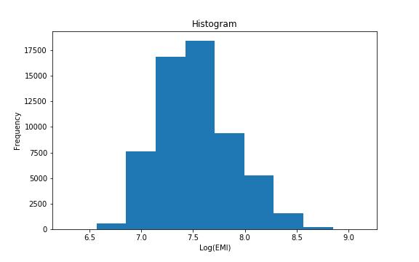
PREDICTIVE DATA ANALYSIS
FEATURE GENERATION:
One hot encoding: one hot encoding with most of the categorical variables as we are using tree based model.
Extracting locations from Pin-code: We have extracted the regions of the customer to which they belong by categorizing their location based on the first two digits of the Pin code.
Logarithm of the EMI data has been taken to remove the skewness of the data.

Slide 12

PREDICTIVE DATA ANALYSIS
Variables V25 and V26 indicate the fraction of time customers were assigned various agencies separately. We have clubbed them together to get the required information as a single feature.
Variable V13 is Aadhar information whereas V23 is PAN Card/ Voter ID information both have been clubbed together as they indicate the identity of customers.
XGBoost and Random forest are two tree based model which have been used here to classify customers in two classes of N and N+1 buckets. In addition to this, method parameters are tuned to minimize error rates.
Confusion matrix achieved using XGBoost is show below. Error rate in this case is .14 which has been validated by 10-cross validation.

Slide 13
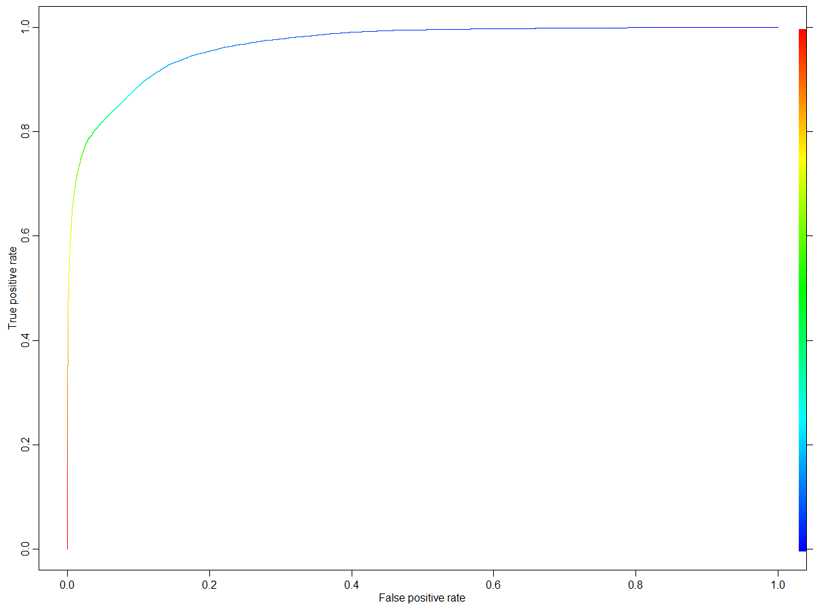
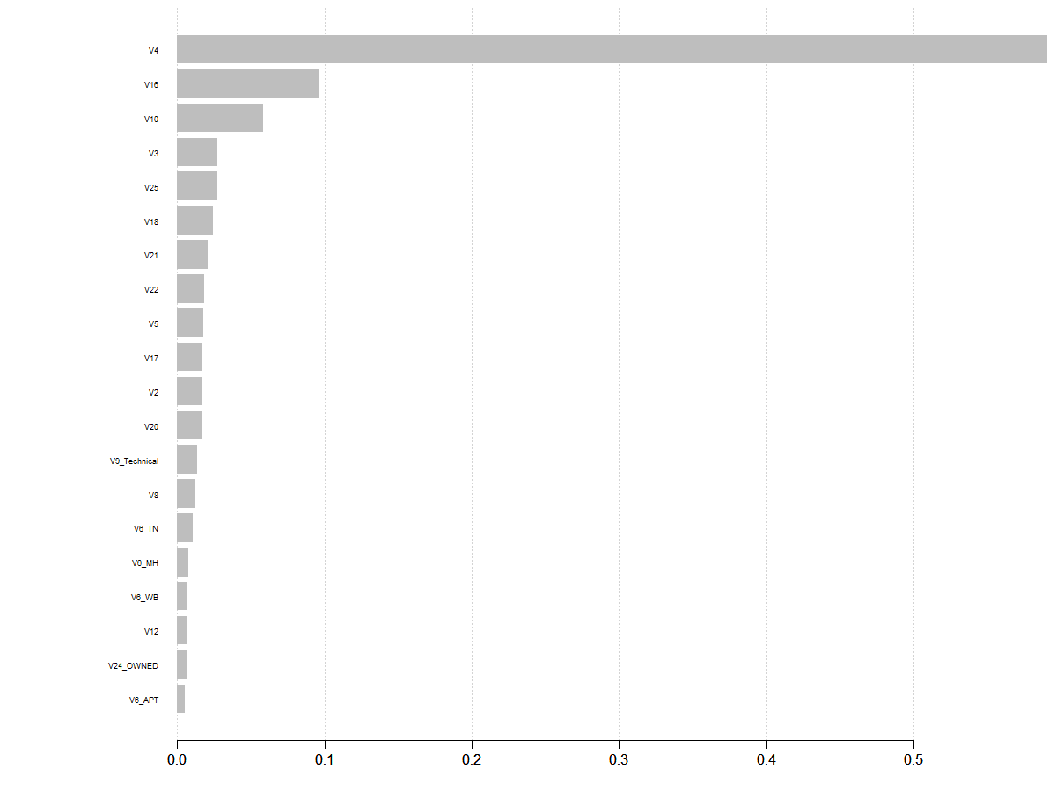
PREDICTIVE DATA ANALYSIS
Using aforementioned models, important variables as per splits of the variables which resulted in maximum increase in the accuracy of the model on an average are recorded and a plot indicating the same is shown below.
Threshold had been reduced to accommodate for high AUC value of 88 % to improved the predictability of true positive rates without affecting true negative rates.

Slide 14
CONCLUSION & DISCUSSION
Following are some of the important variables explaining the defaulting costumers:
Variable ID | Description
V4 | Number of times the customer flowed in the last 3 months
V16 | EMI
V10 | Average delay in EMI payment (delay is the difference between the payment date and presentation date)
V3 | Total number of times the customer flowed so far
V25+V26 | Fraction of times the customer was allocated to agency
V18 | Qualification
V21 | Indicates the maximum continuous mobs in which the customer flowed
V22 | Tenure
V5 | Total enquiries made by the customer in the last 9 months
V20 | Number of times the customer flowed/MOB

Slide 15
CONCLUSION & DISCUSSION
It can be fairly said that V4, Number of times the customer flowed in the last 3 months, is the most important factor in predicting whether a customer is a potential defaulter.
Variable V4 is followed by (V16) EMI amount, and (V10) average delay in EMI payment.
Variable V3 which indicates total number of times the customer flowed so far also affects the chances of a customer defaulting
It is also of important to note that surrogate, state (derived from PIN code) and resident type do not contribute much towards the assessment of customers defaulting on payments.

Slide 16
FUTURE SCOPE AND RECOMMENDATIONS
Based on the variables following is recommended for TVS credit. It is observed that customers defaulted for last 3 months are highly likely to default in current month as well . Hence, It is prudent for TVS Credit to generate a mechanism which can identify such customers and store the information to improve their database. Such database might be leveraged to estimate whether a customer is a prospective defaulter.
In addition to the above, to improve the predictability of ML model developed, further feature engineering on the variables shall be performed and the model shall be retrained.
Further, other ML tools for classification might be performed on the trained data and scope of improved in test accuracy may be assessed.
Note: All the relevant R-Code of ML model and the dataset are enclosed along with this presentation.

